Slide 1
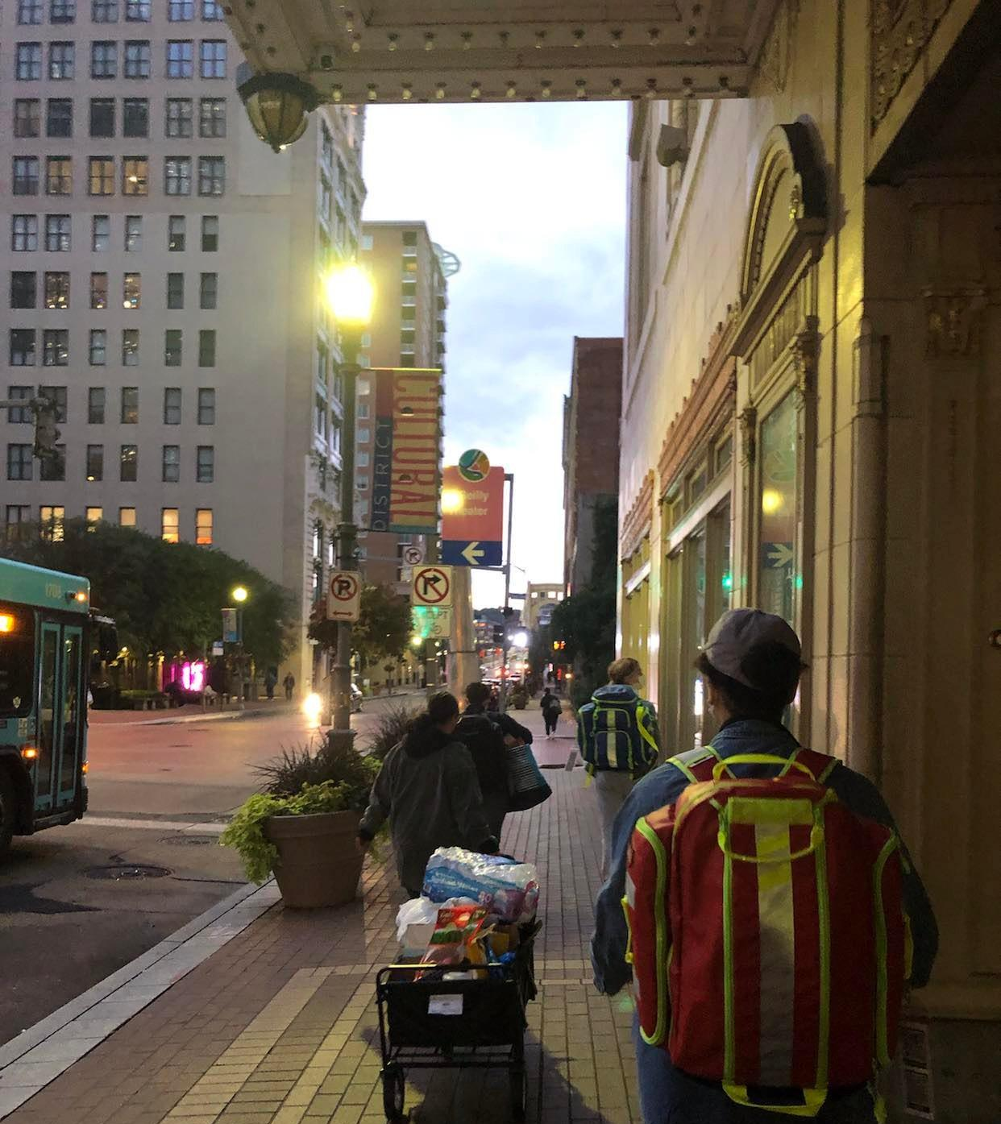
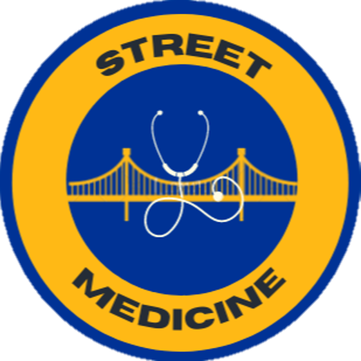
Street Medicine at Pitt
September 24, 2024 Event
A student-led interdisciplinary organization supporting the unhoused community in Pittsburgh, PA

Slide 2
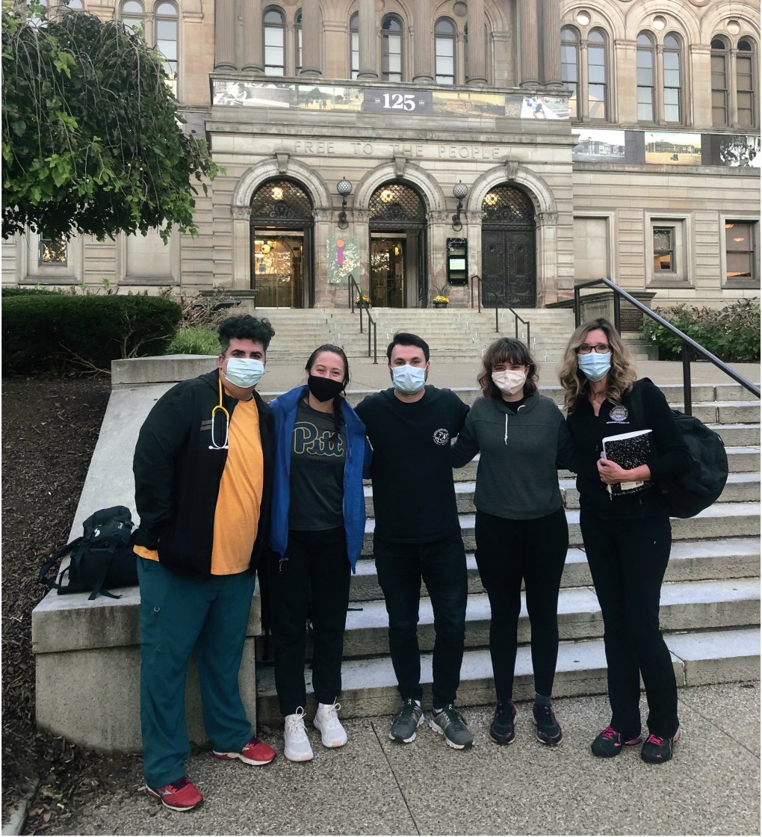

About Us
Founded in 2021 and inspired by Pittsburgh's rich history as the birthplace of street medicine
Current student membership has grown to over 400 general body members and over 70 street rounds volunteers.
Two core clinicians (Med-Peds, PM&R), student leadership board and advisors
Interdisciplinary and interprofessional: previous collaborations with Public Health, SHRS, Pharmacy, Dental, and Social Work.

Slide 3
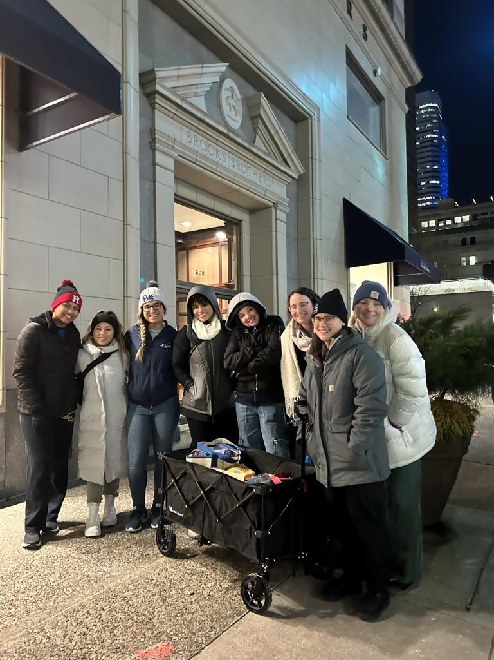
Our Values
1
Authentic, relationship-based care
2
Interprofessional teamwork
3
Lens of health equity

Slide 4




Student & Clinician Involvement:
Didactic Events
Community Volunteering
Street Rounds
Research

Slide 5
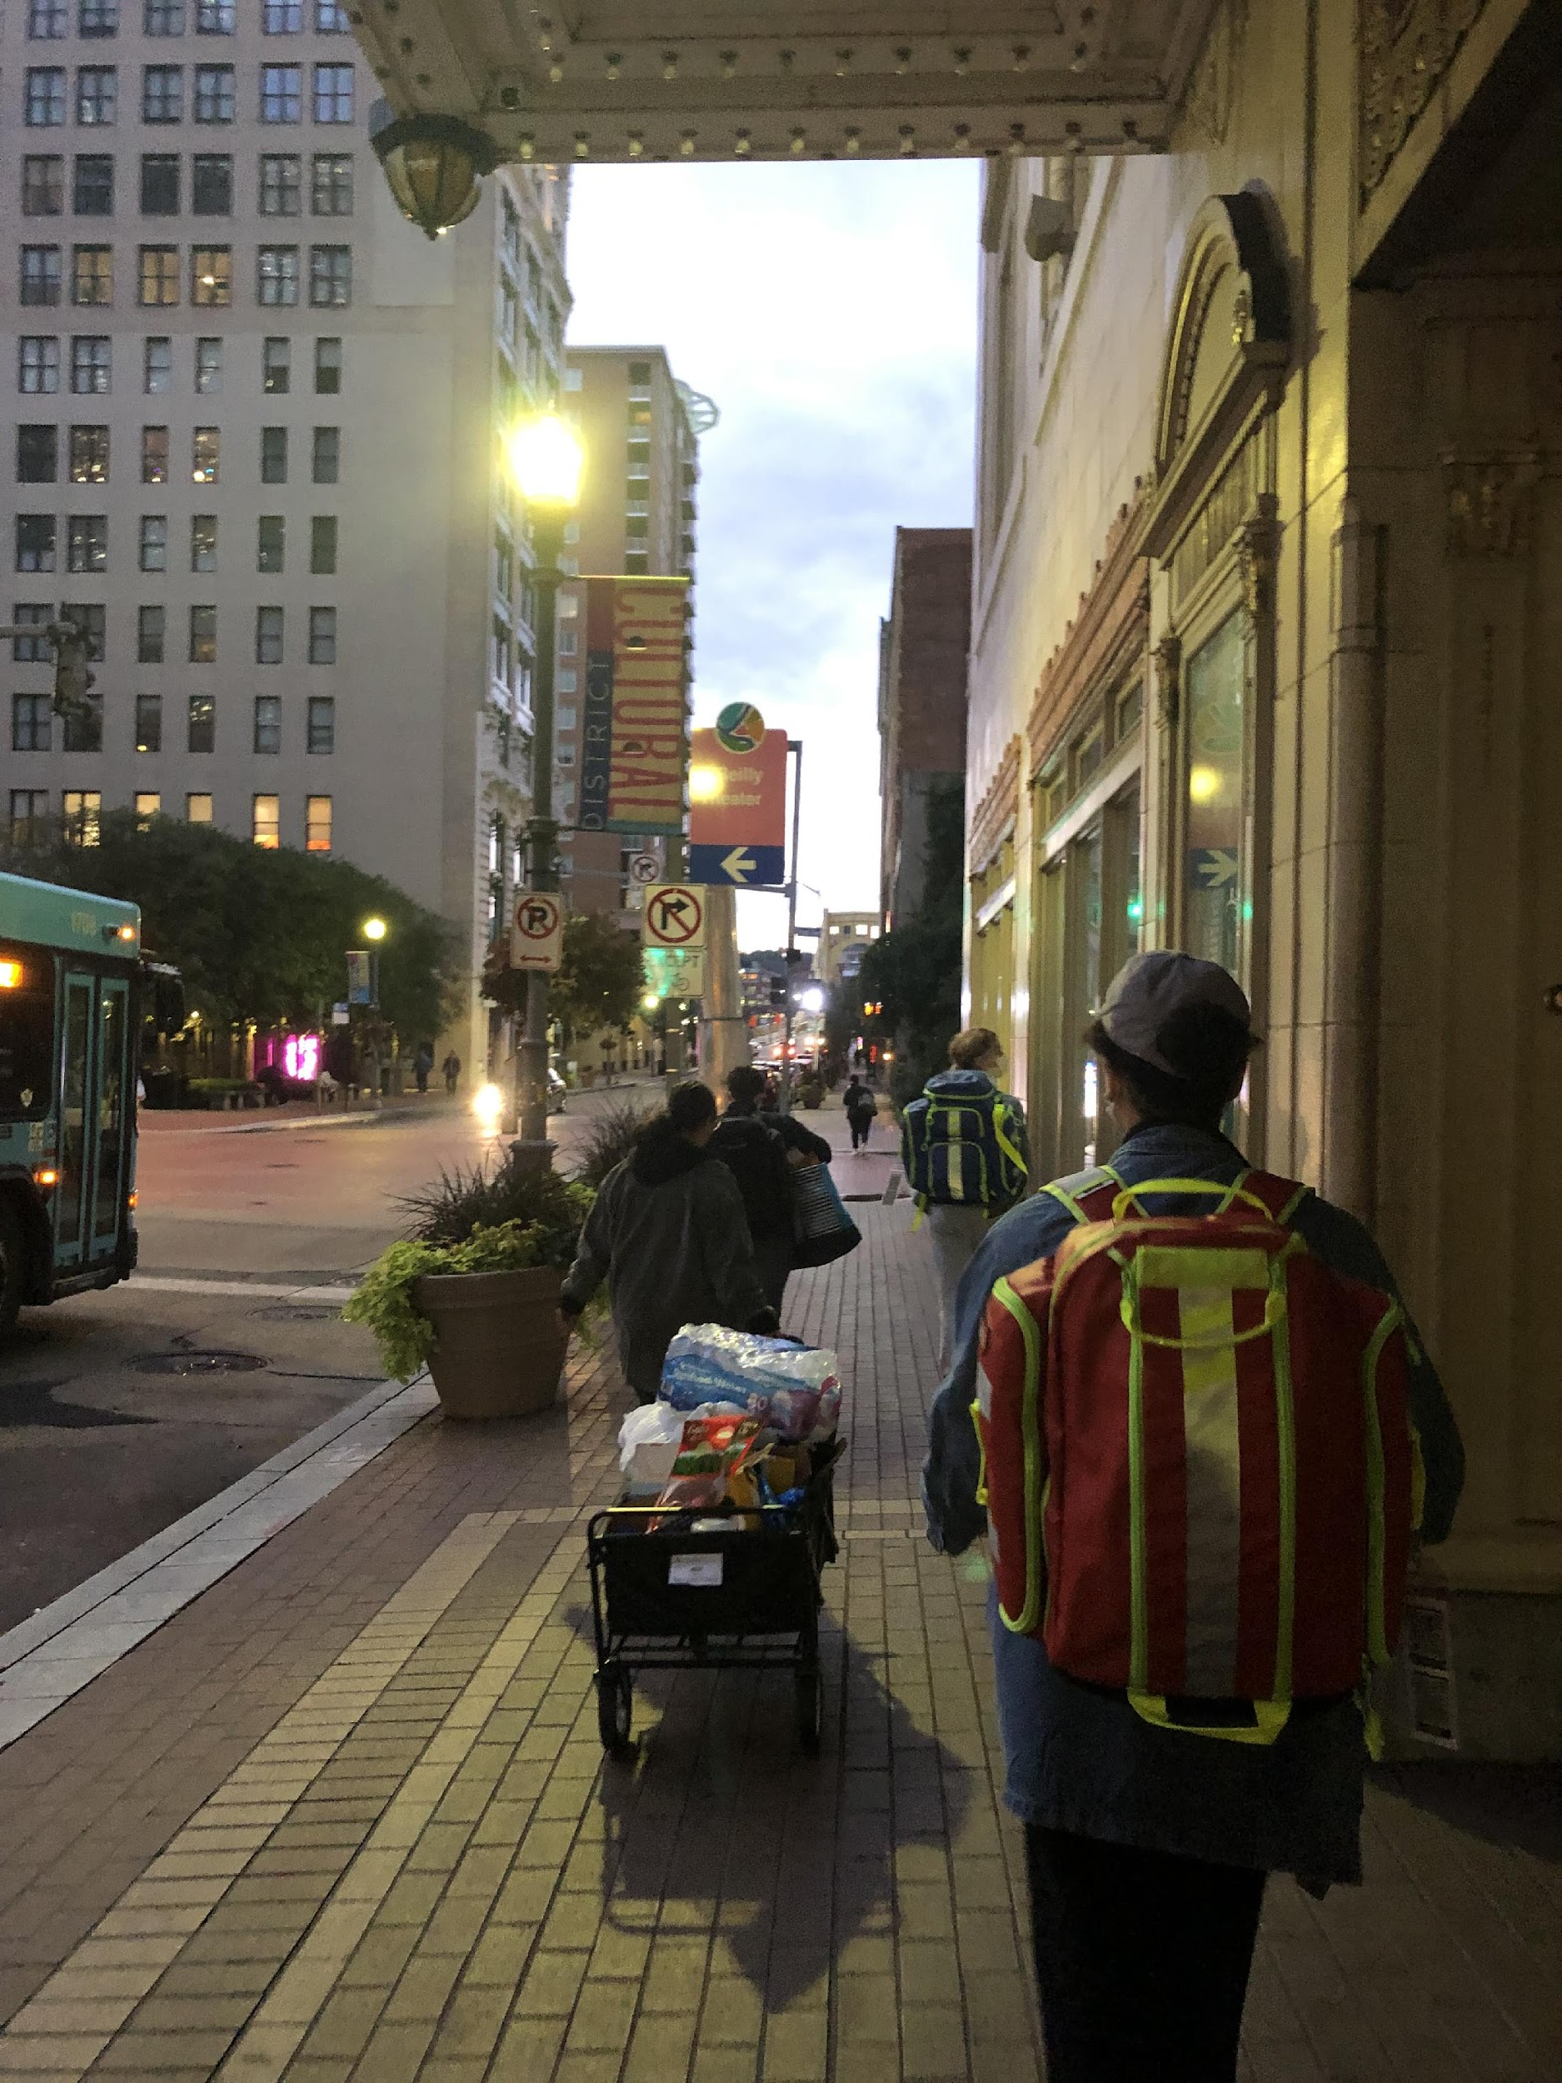
Street Rounds
Interdisciplinary healthcare outreach to provide medical care, basic needs, connection to resources, relationship and trust building to those experiencing unsheltered homelessness
Consists of walking through Pittsburgh (Downtown, Oakland, Shadyside, etc.) to meet with unsheltered individuals where they are instead of requiring them to come into clinic environments that may be inaccessible, stigmatizing, or traumatizing
We go on rounds weekly, Wednesday nights at 6:30 PM

Slide 6
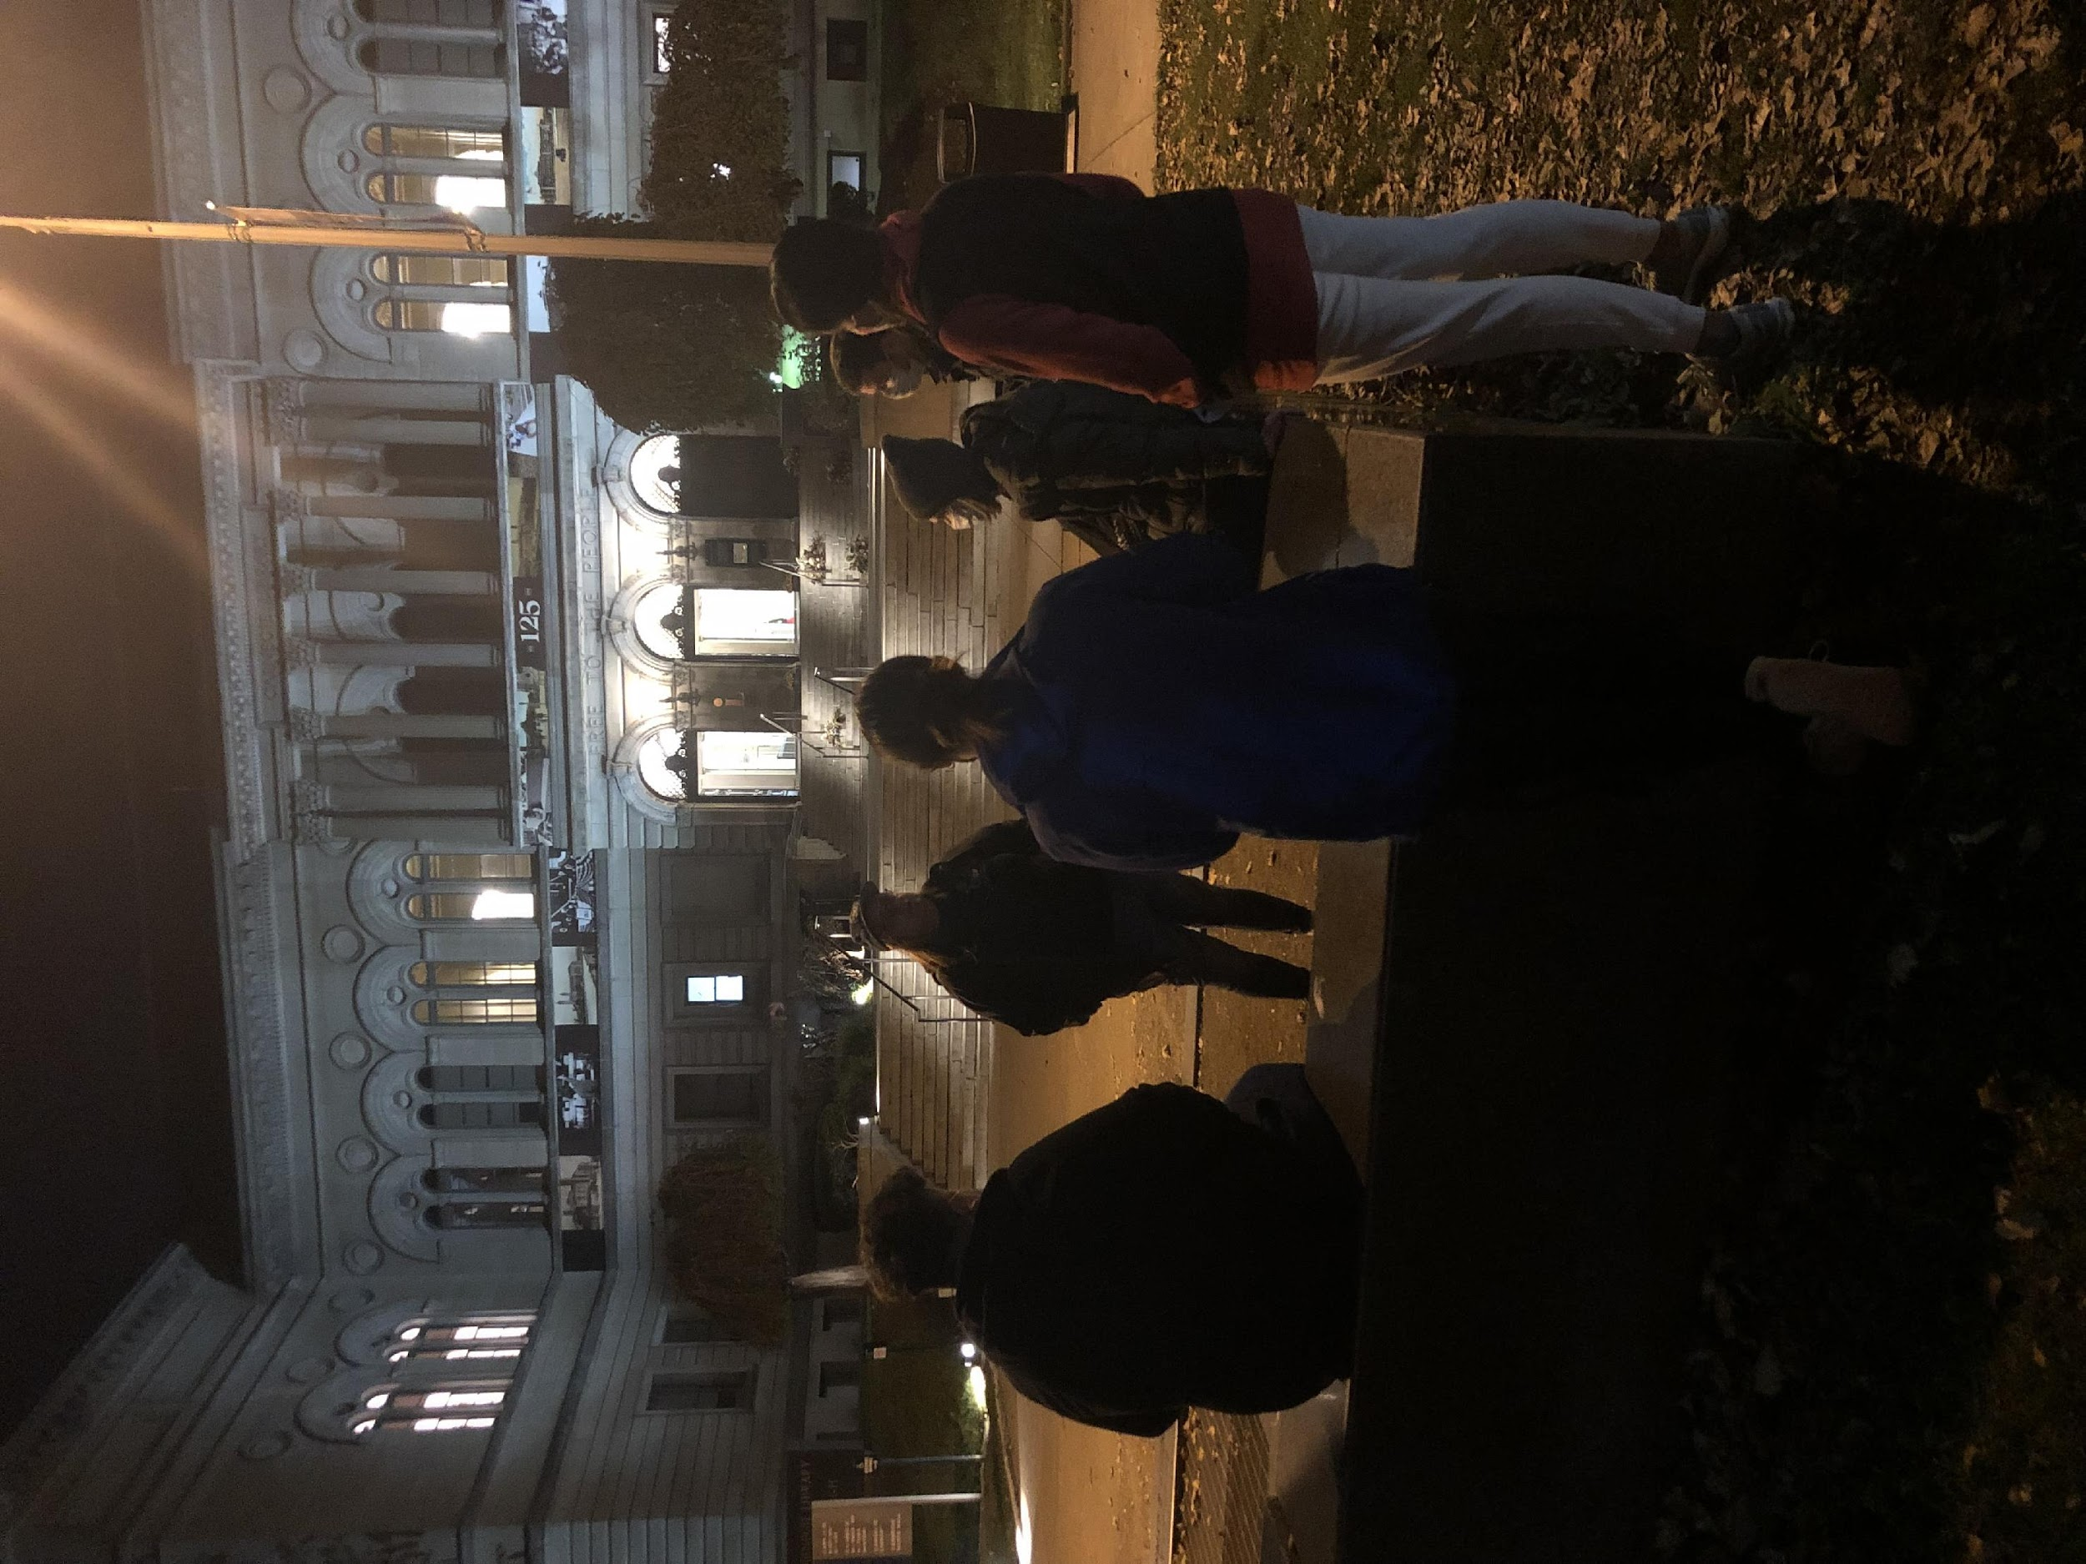
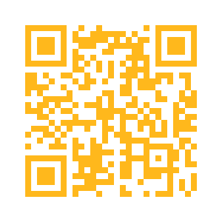
Current Street Rounds Onboarding
Orientation
Includes membership tracking, asynchronous video and quiz on street medicine values, best practices and safety guidelines: www.streetmedatpitt.org/orientation

Slide 7
Foot Wash Clinic
Formerly at 2nd Avenue Commons
Might be back in November
Setting up at ROOTS clinics (Reaching Out On The Streets)
Providing foot care under the supervision of Nurse Em
Vascular health screening w/ vascular surgery consult

Slide 8
Supply Coordination
Weekly Sam’s Club Runs for frequently used supplies
Pickups for locally sourced food and donations
412 Food rescue
Supply committee doesn’t have to be a weekly occurrence:
Can volunteer when you have time and as many times as you would like
For more information on joining the resource committee please reach out to add14@pitt.edu or adv71@ pitt.edu

Slide 9
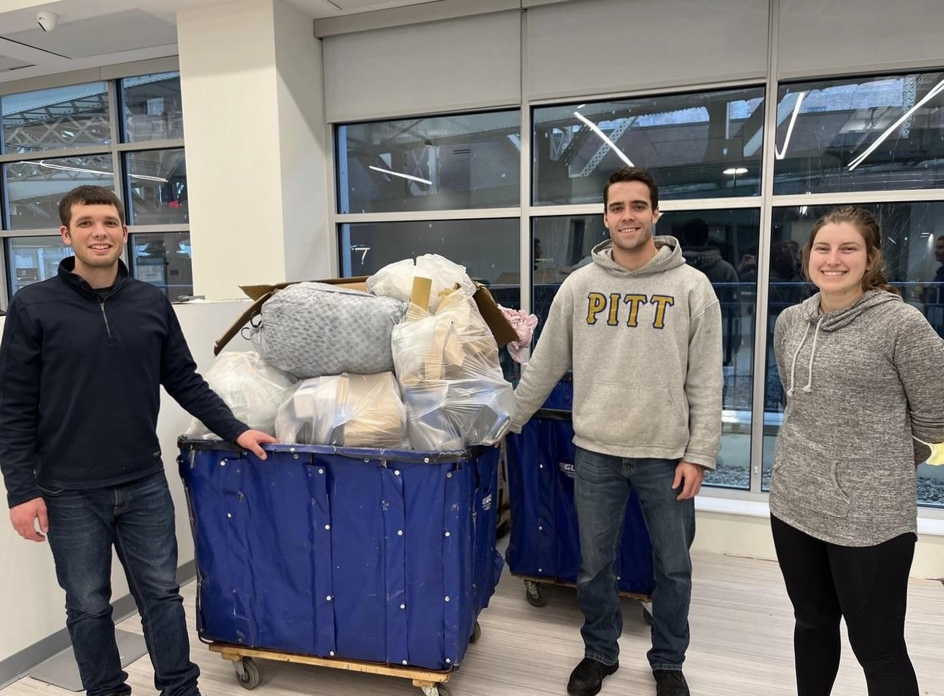
Volunteer Opportunities
Community Human Services food pantry
Operation Safety Net warehouse
Making sandwiches/care packages at SM@P events
Donation drives
Fundraising
Resource management (organizing donations)

Slide 10

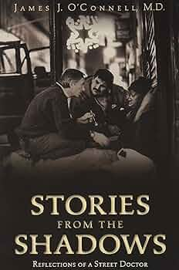
Didactic Events
Guest speakers
Panels
Workshops and trainings
Book club
Journal club
Short film screenings
Service hours

Slide 11
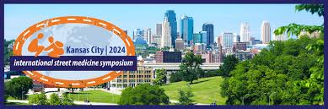
Research
History of ethical involvement in
Quality Improvement and Medical Education research
Open to collaborations with faculty and students interested in research that improves options for our clients
Opportunities to present findings
Requests for collaboration: New dissemination form!
Email: info@streetmedatpitt.org
Ongoing topics of interest include:
Impact of a Street Medicine Consult Service, Lowering the barriers to buprenorphine access
Barriers to care in the ER

Slide 12
Involvement so far from 26 areas of practice:
Health and Rehabilitation Sciences (SHRS)
Medicine
Public Health
Pharmacy
Pediatrics
Internal Medicine
PM&R
Emergency Medicine
Addiction Medicine
Psychiatry
Family Medicine
Podiatry
Palliative Care
Med-Peds
Behavioral and Community Health Sciences
Health Policy and Management
Epidemiology
Social Work
Occupational Therapy
Nutrition
Athletic Training
Emergency Medicine
Physical Therapy
Physician Assistant
Audiology
Dental
Nursing
Psychology
Undergraduate Studies

Slide 13
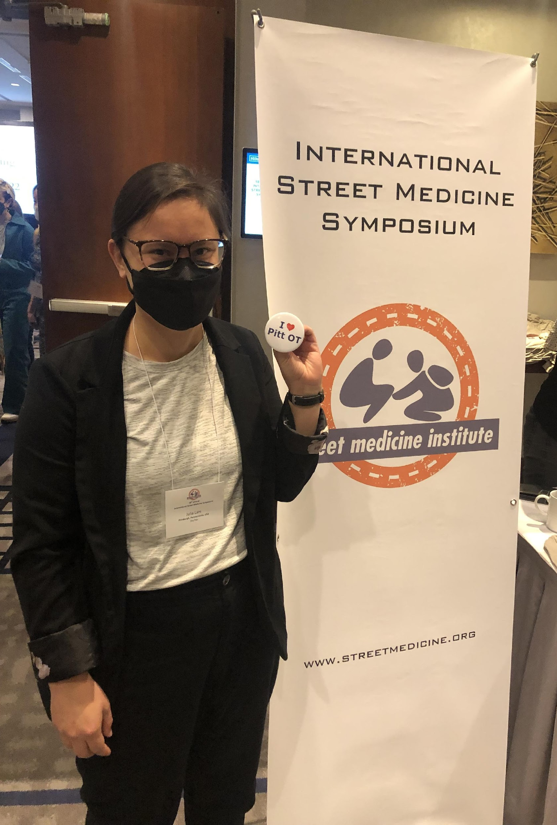
Participant Testimonies
“Each encounter was different, but equally rewarding. I appreciate that unlike traditional clinics, street medicine requires a greater degree of flexibility, problem solving, and empathy.”
Lee Varelas, MD, PGY-1
"My expectations were definitely met - maybe even exceeded. I was surprised by how it was more about material and food needs for folks. A lot of them just wanted someone to listen. A lot of folks also have a distrust of medicine (rightfully) and knowing that this is often the case for marginalized folks is always a good reminder. Definitely will be going on rounds again."
Street Rounds participant, September 2022

Slide 14
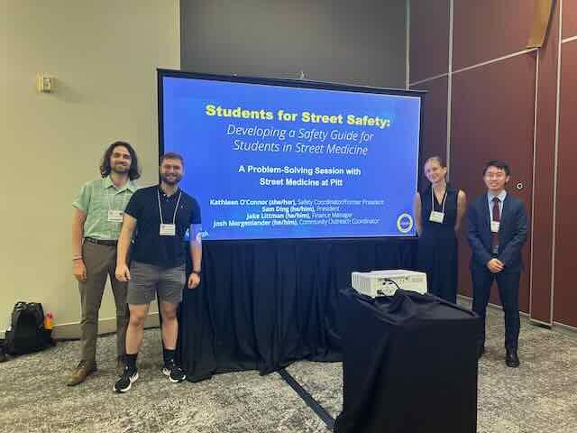
Recap of the International Street Medicine Symposium
What is the Street Medicine Institute?
ISMS: clinical topics, innovations, research outcomes, and best practices
Lectures, presentations, workshops
Kansas City, 2024.

